Slide 1





MEET DOROTHY
A Supply Chain leader
She manages the supplies from Asia
for Nord Electronics AB
She wants to know how typhoons effects their business

Slide 2

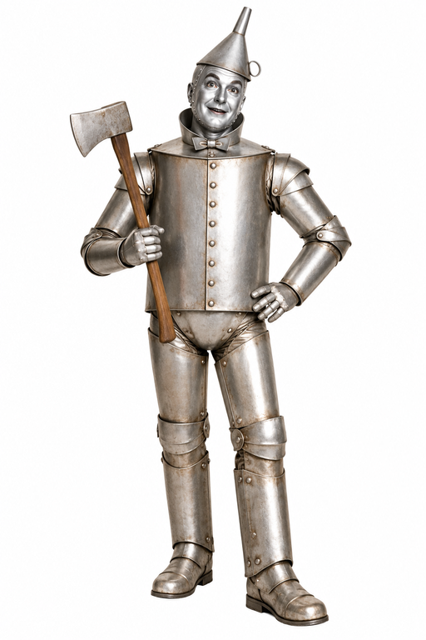






Contract Analyst Agent
Brief
Inventory Analyst Agent
News Scout Agent
War Room Lead

Slide 3
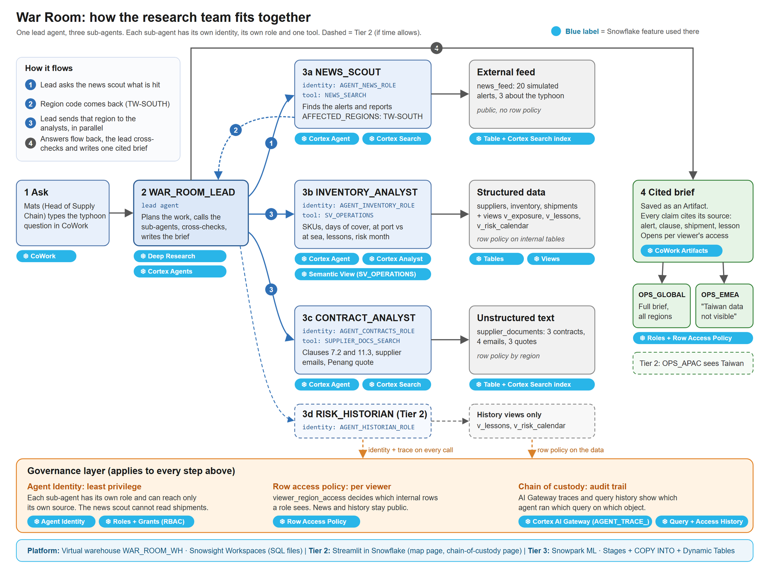

Slide 4

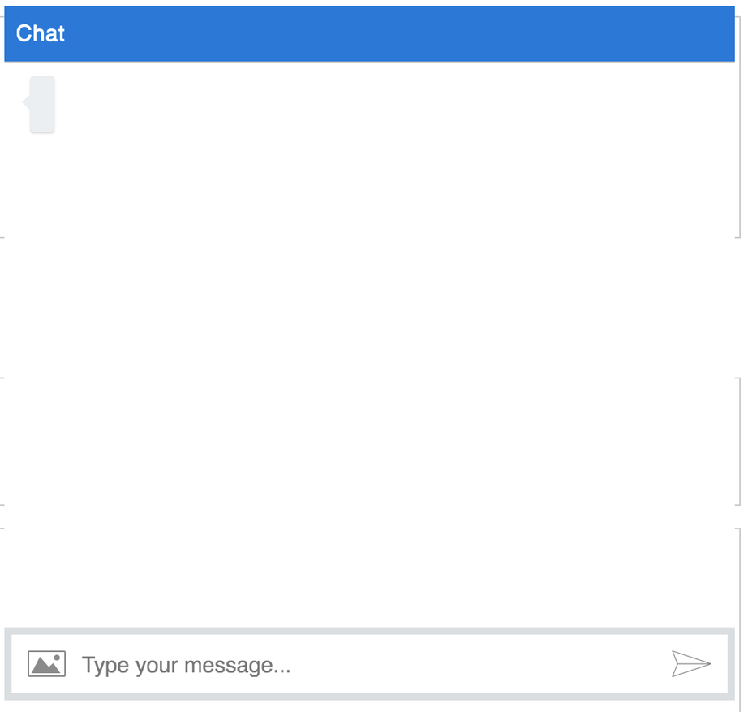
DATA GOVERNANCE & SECURITY POLICY
Show me the data!
You are a dog,
you are not supposed
to see the data

Slide 5

THANK YOU
VERY MUCH

